Slide 1
WISHES 4 KIDS
PRESENTATION

Slide 3
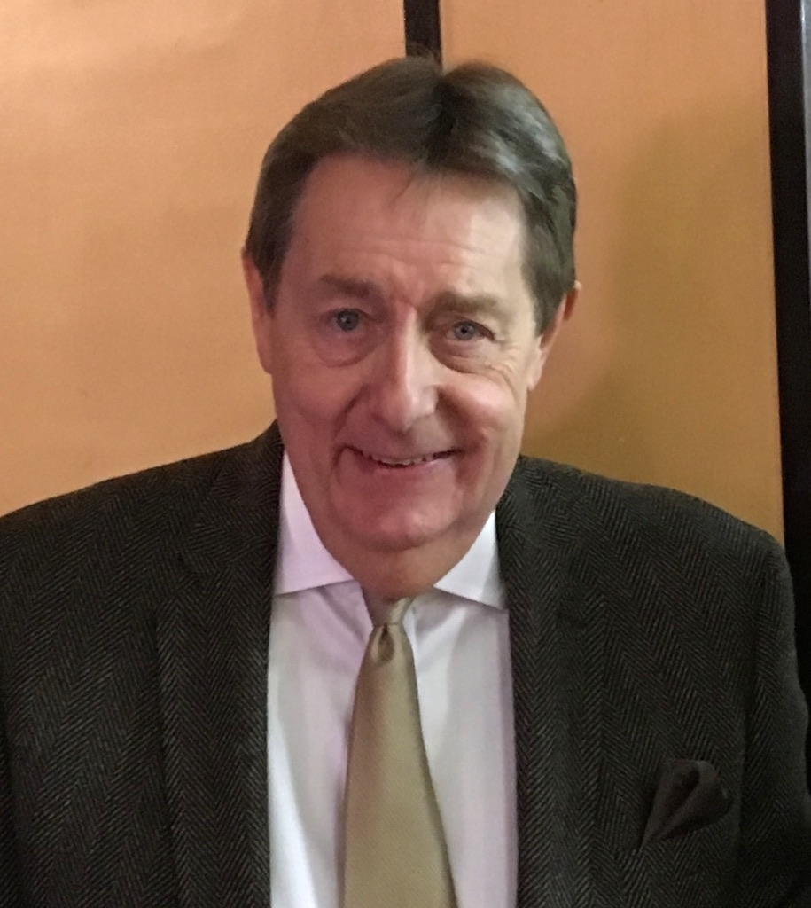
In September 2002, Russell Brickett founded the Wishes 4 Kids children’s Charity.
Russell wanted every child that had a wish granted to be happy and be able to forget their suffering for a short time.
Sadly Russell passed away on 19th April 2018. He is sorely missed by everyone who knew him.
Russell Brickett
Wishes 4 Kids Founder

Slide 4
Wishes 4 Kids was created to grant a wish for Leicestershire children who are life limited, terminally ill, have experienced life-changing physical or emotional traumas or have suffered major abuse. The Charity grants wishes for those of eighteen years and below.

Slide 5
Sadly we do not have a magical cure for the suffering of these youngsters, however, we can bring a short period of respite.

Slide 6
The time when a child has a wish granted is a moment that will be treasured by them for the rest of their life.

Slide 7
Each child is invited to make three wishes – it is then our challenge to make one of them come true.

Slide 8
The Charity has granted nearly 7000 wishes to date and over the last four years are averaging over a wish a day. Here are a few examples of some of those wishes -

Slide 9
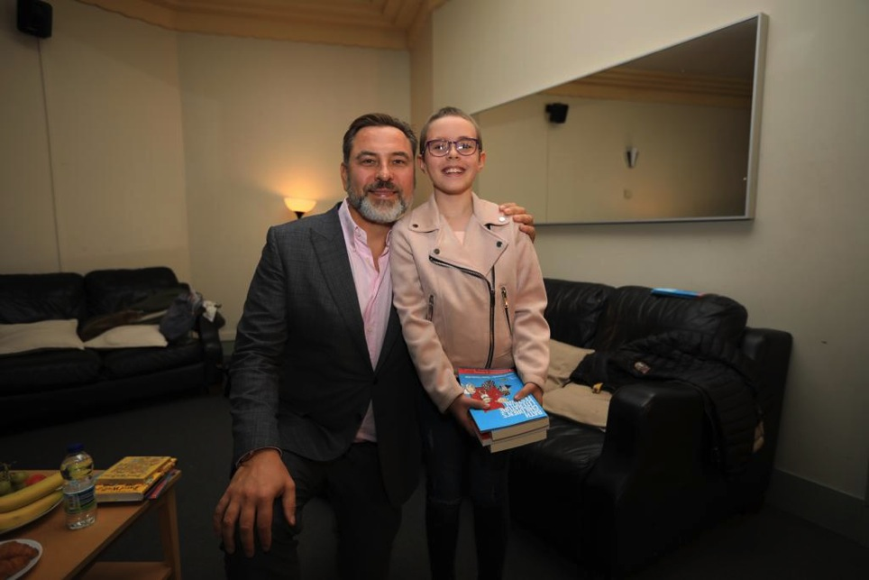

Slide 10
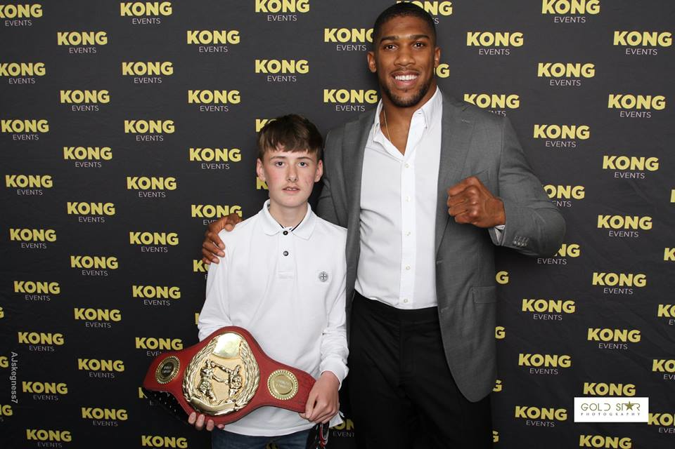

Slide 13
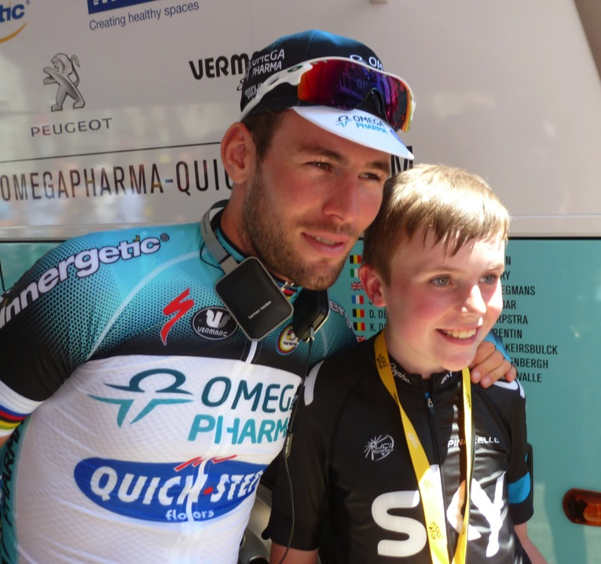

Slide 14
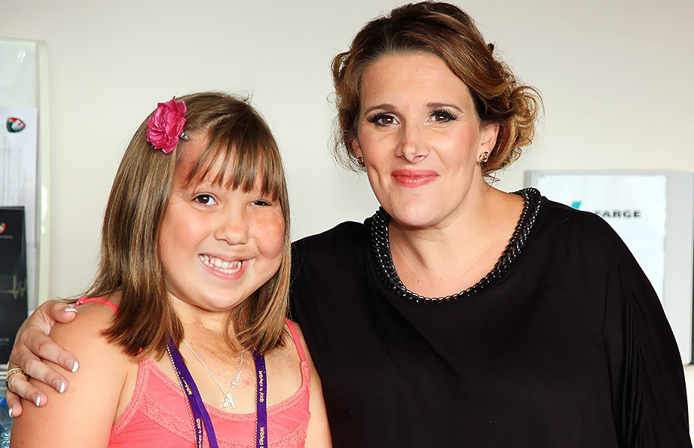

Slide 15
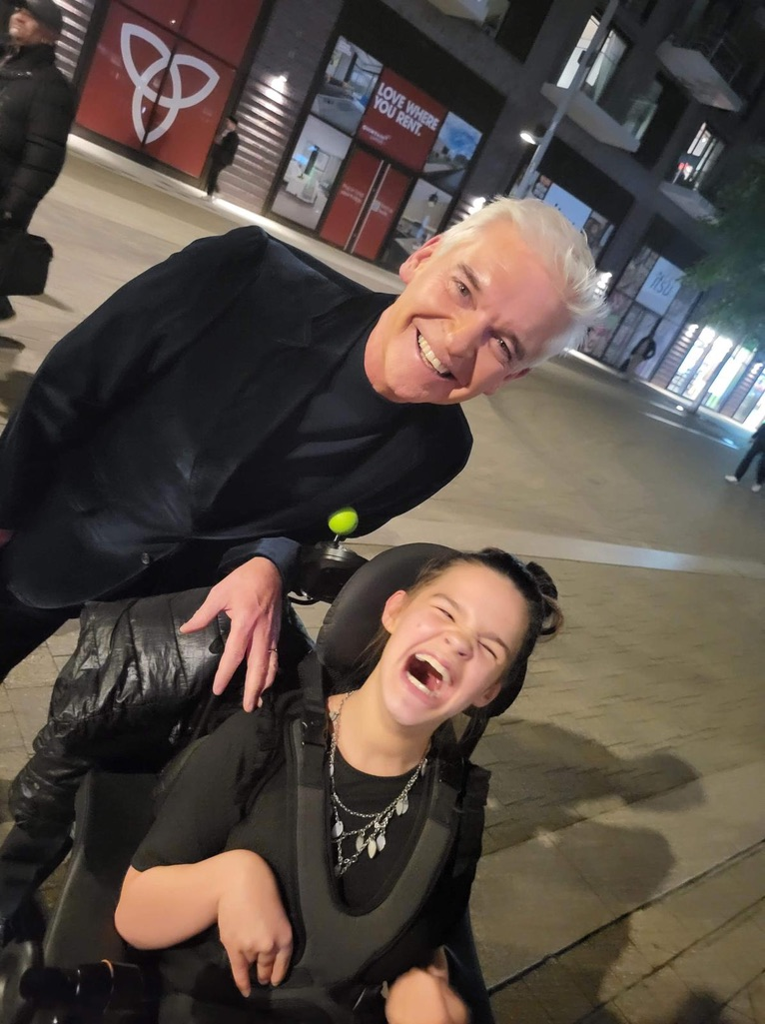

Slide 16
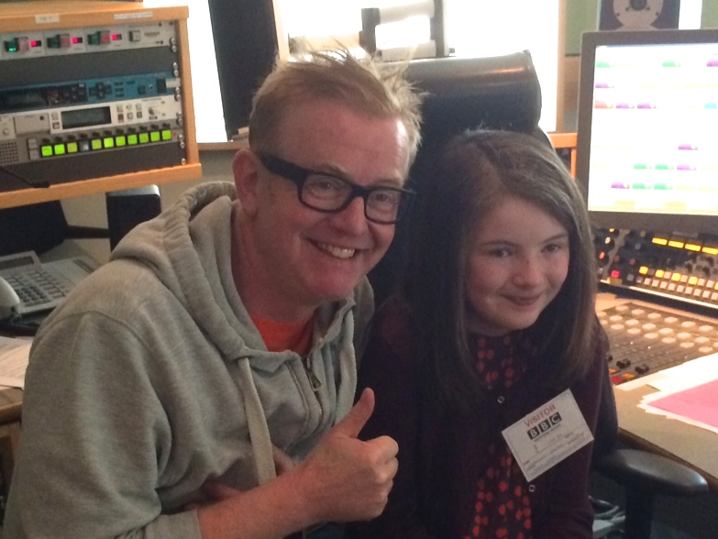

Slide 17
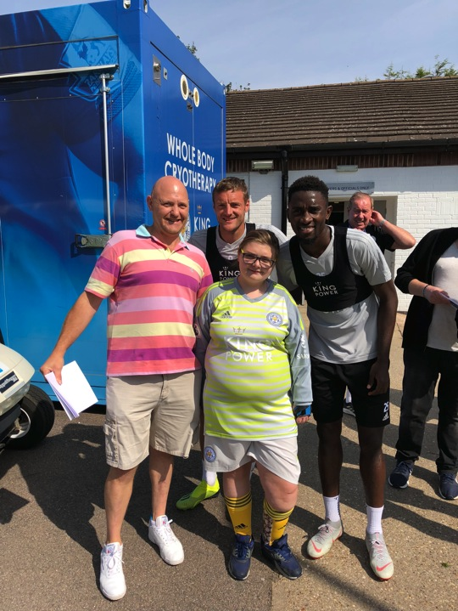

Slide 18
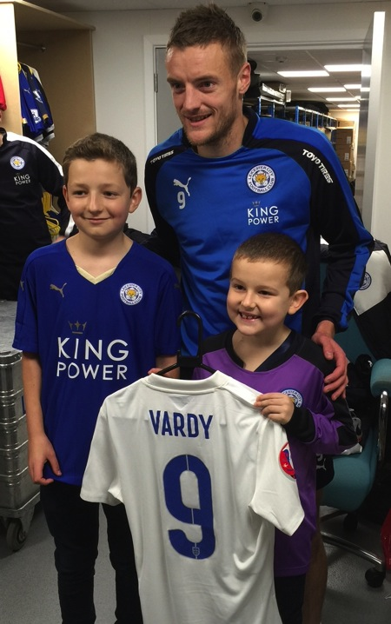

Slide 19
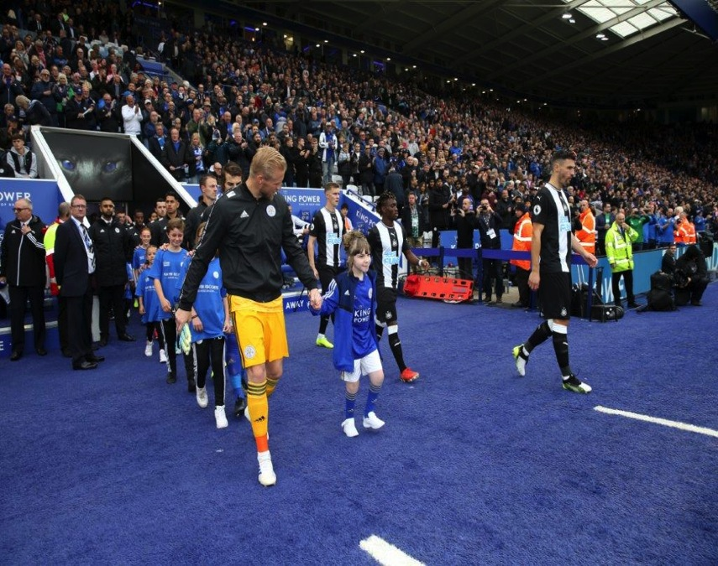

Slide 20
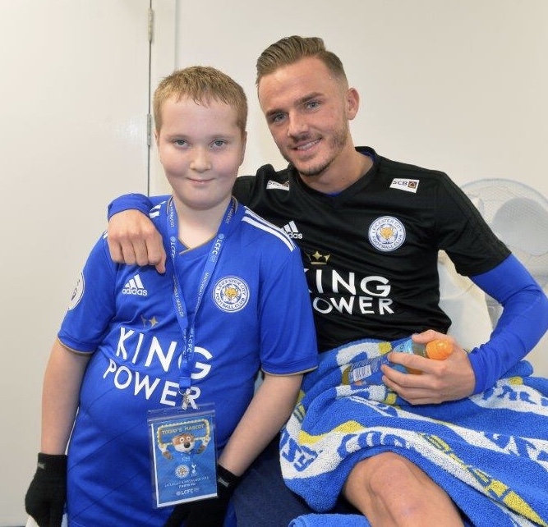

Slide 21
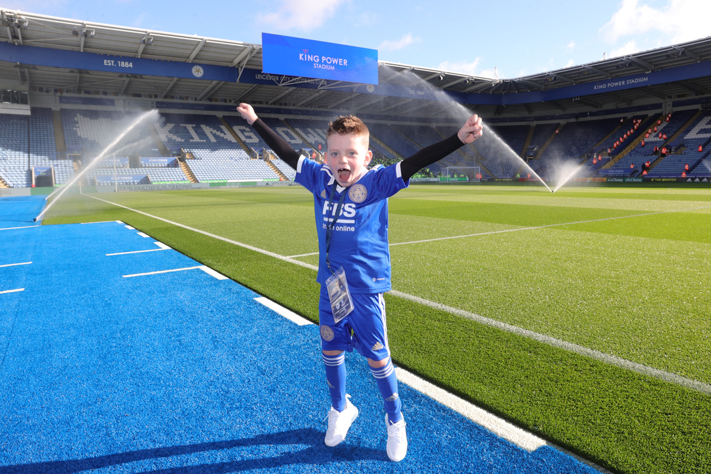

Slide 23
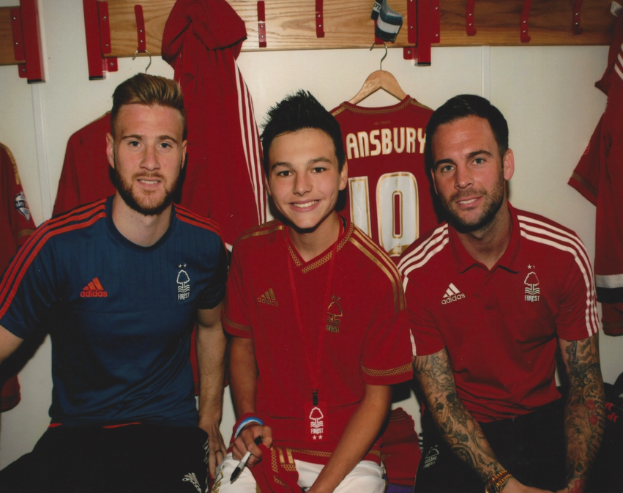

Slide 24
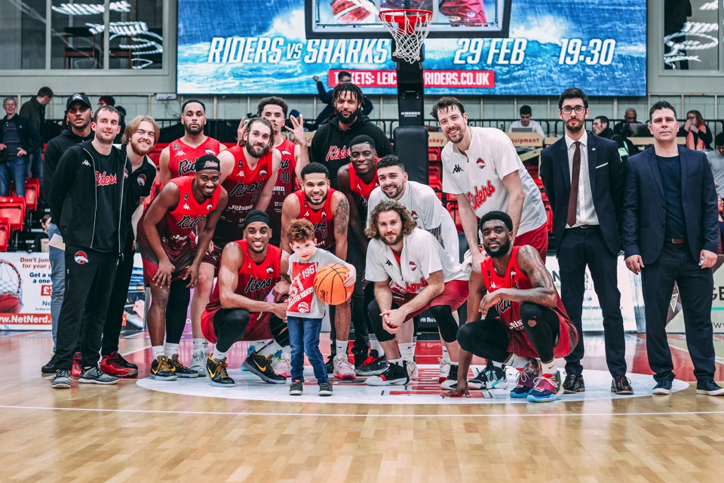

Slide 25
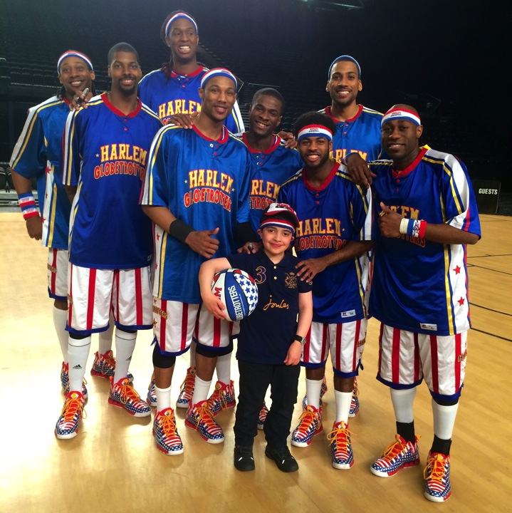

Slide 26
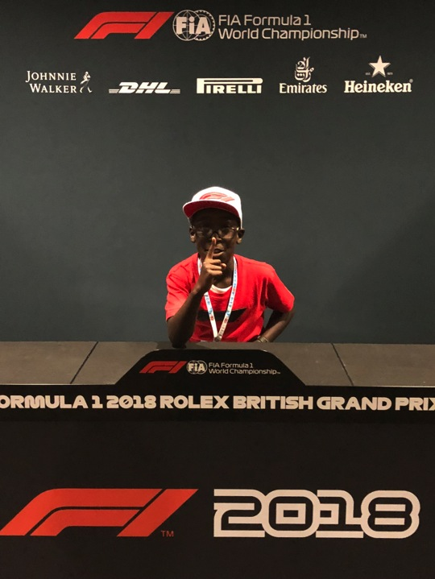

Slide 27
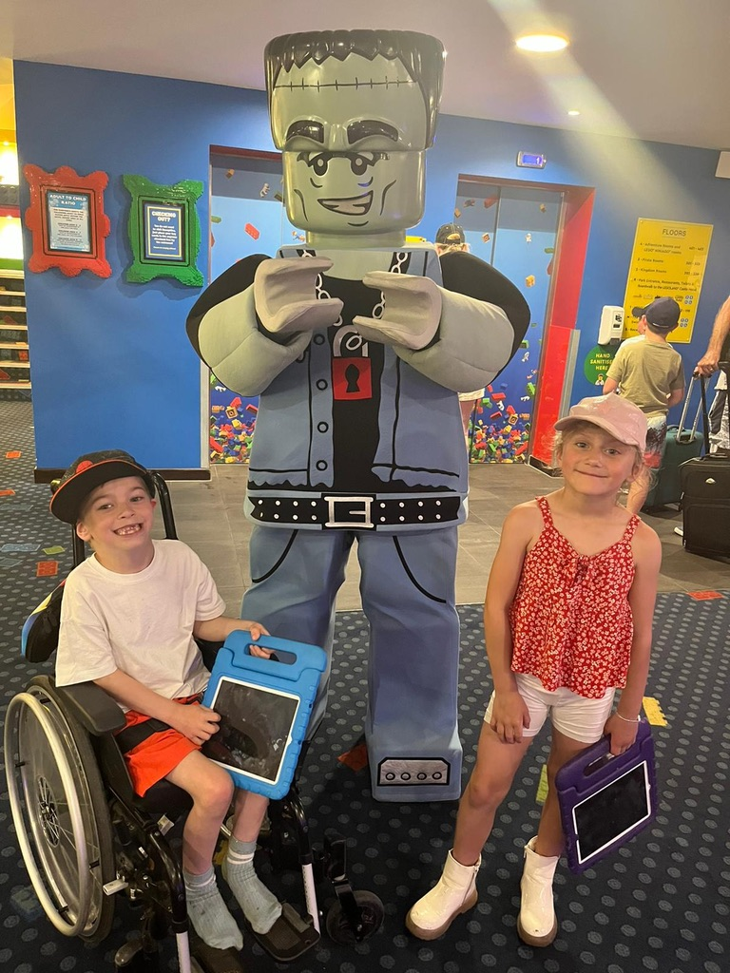

Slide 28
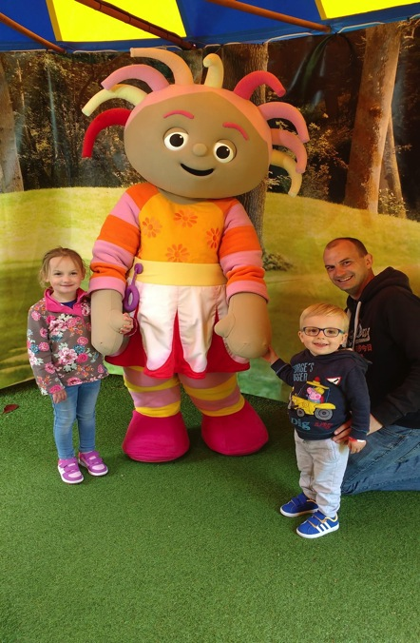

Slide 29
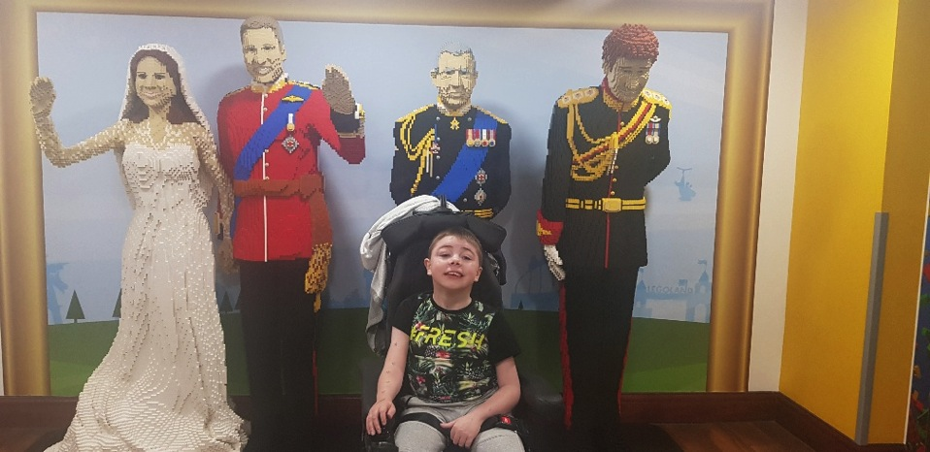

Slide 30
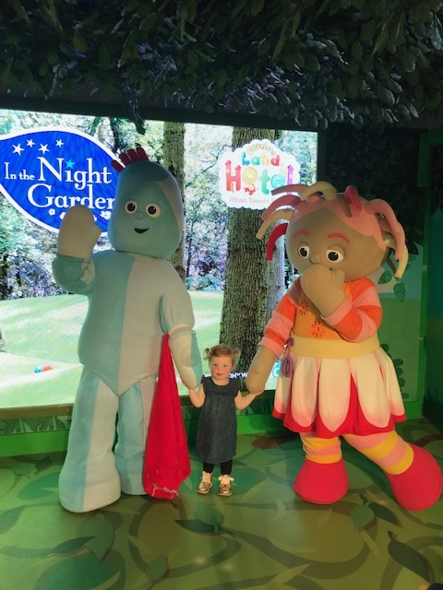

Slide 31
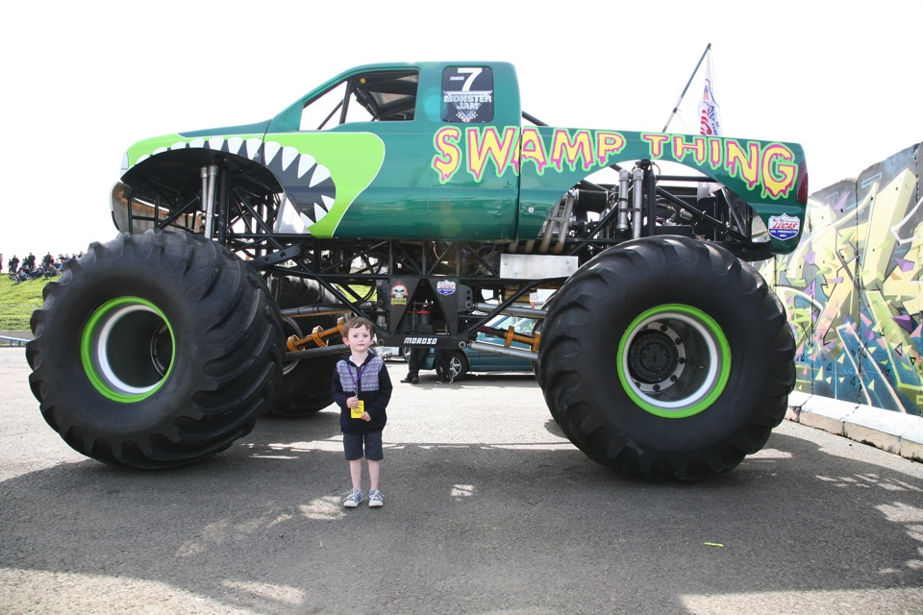

Slide 32
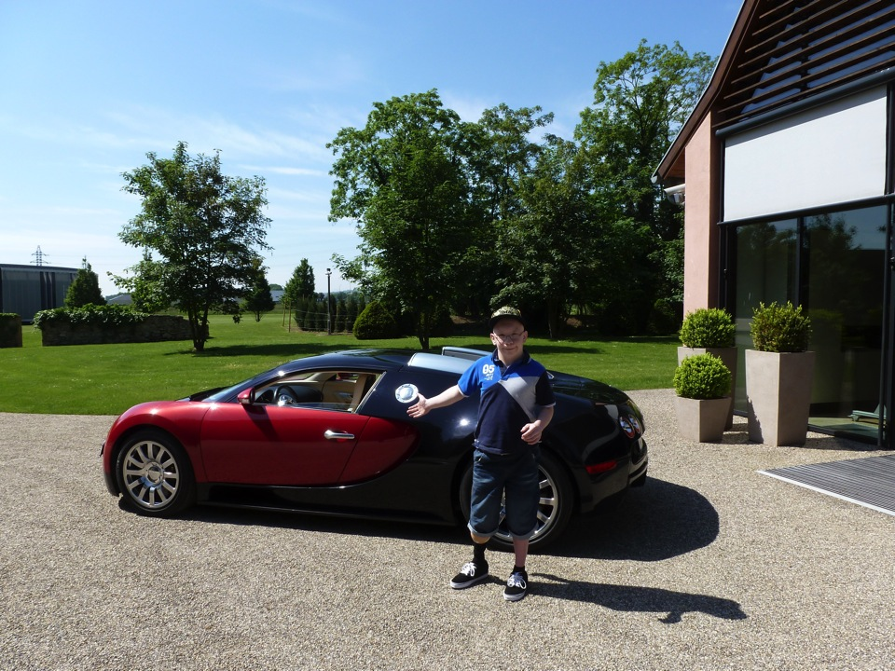

Slide 33
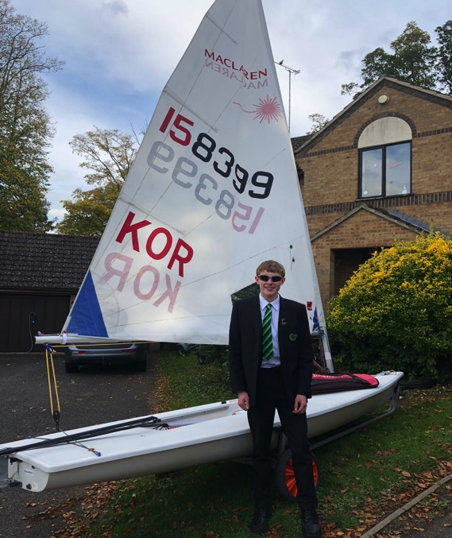

Slide 34
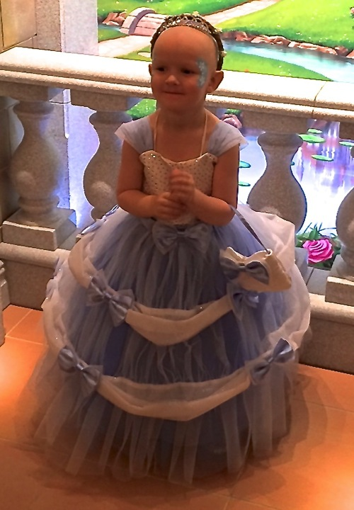

Slide 35
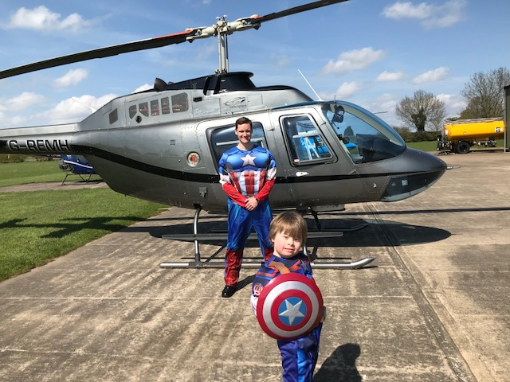

Slide 36
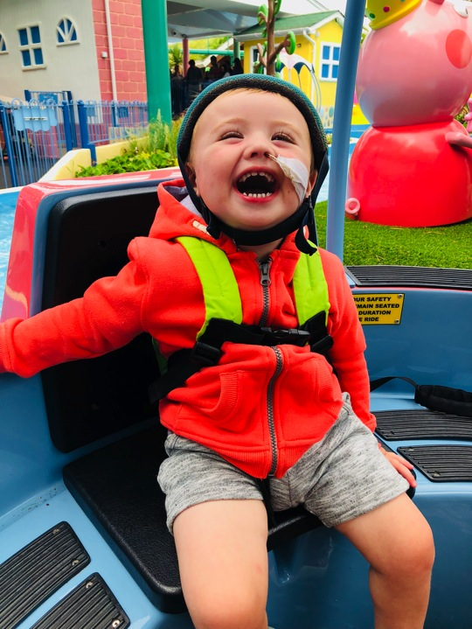

Slide 37
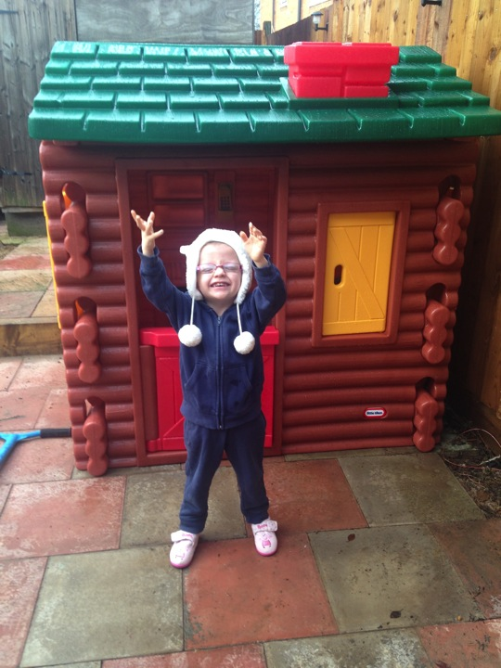

Slide 38
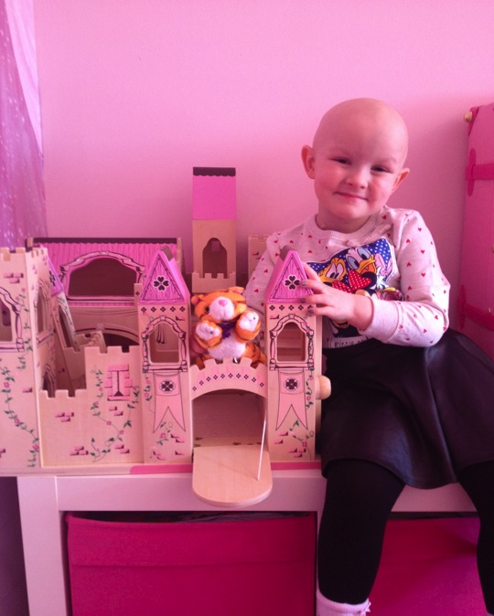

Slide 39
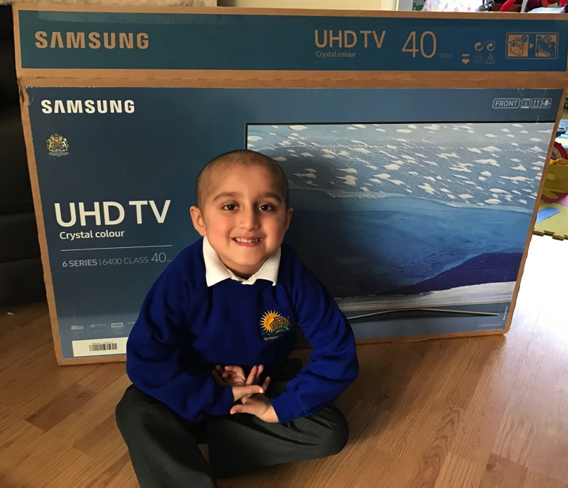

Slide 40
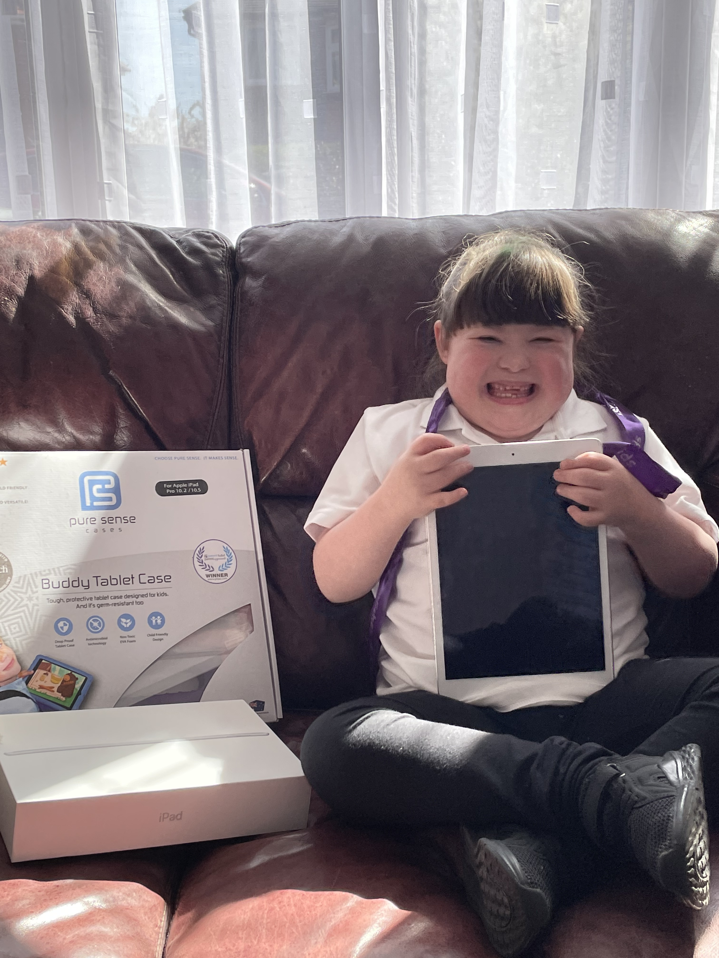

Slide 41
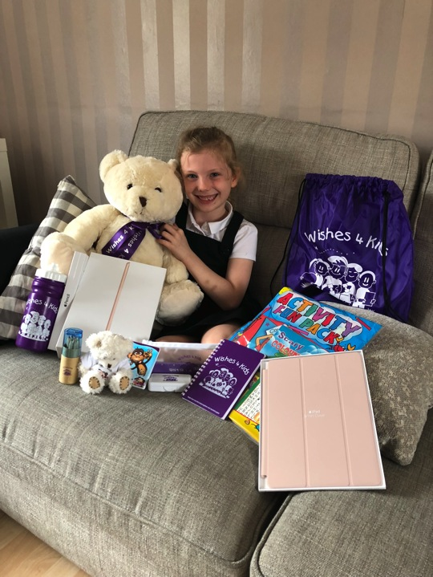

Slide 42
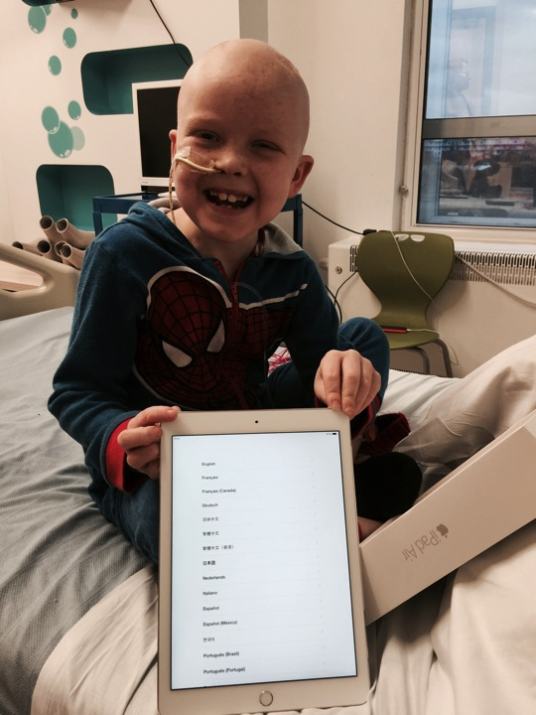

Slide 43
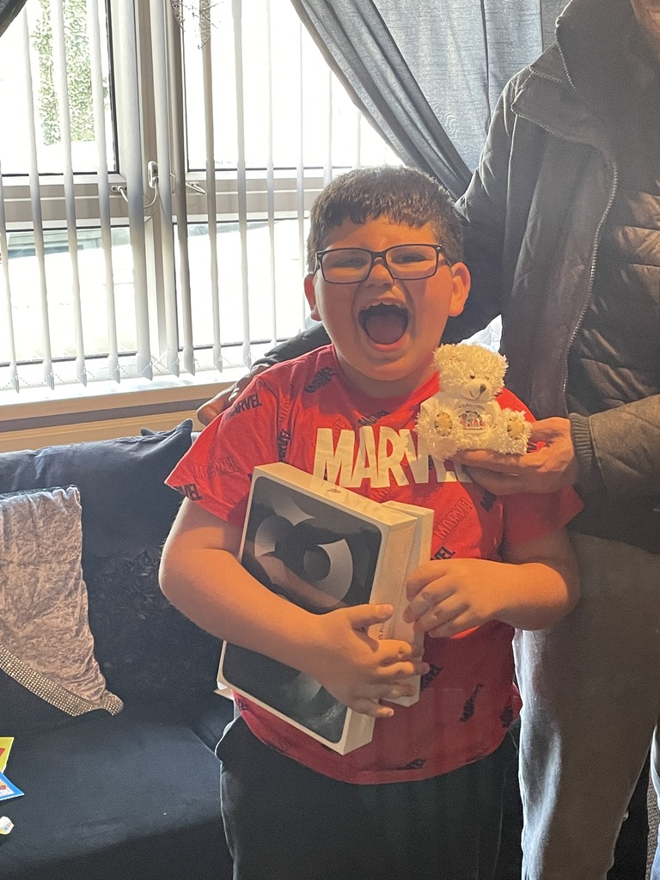

Slide 44
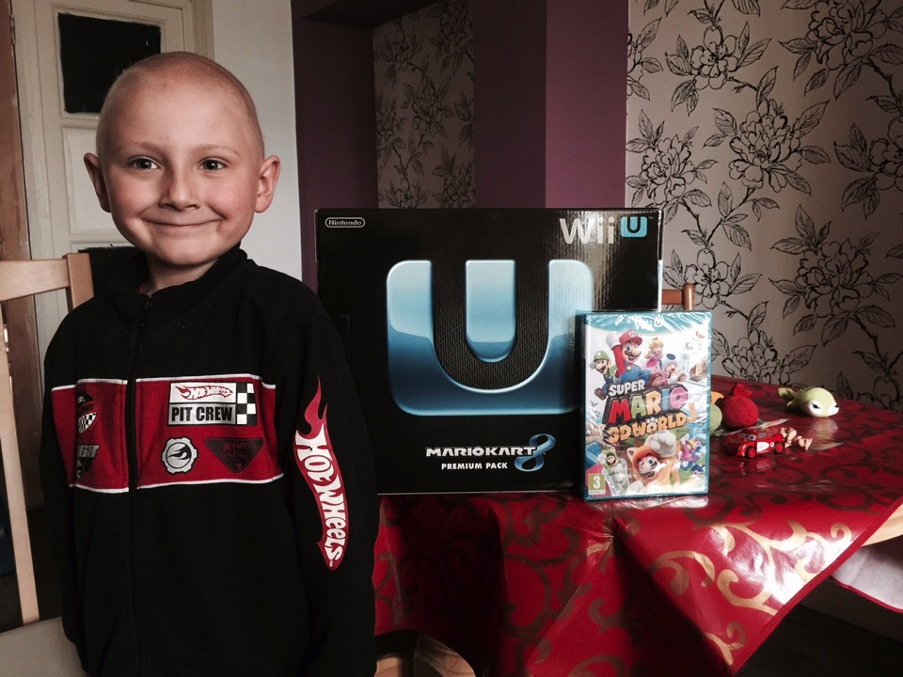
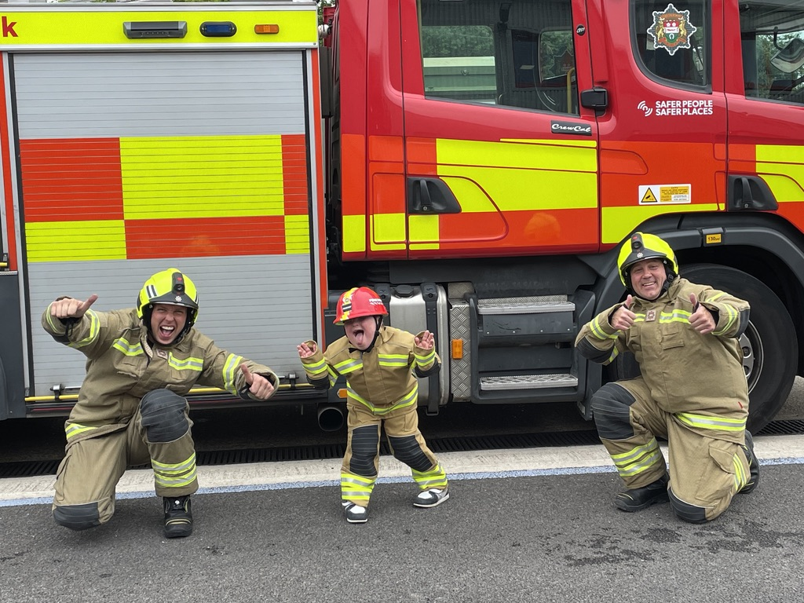

Slide 45
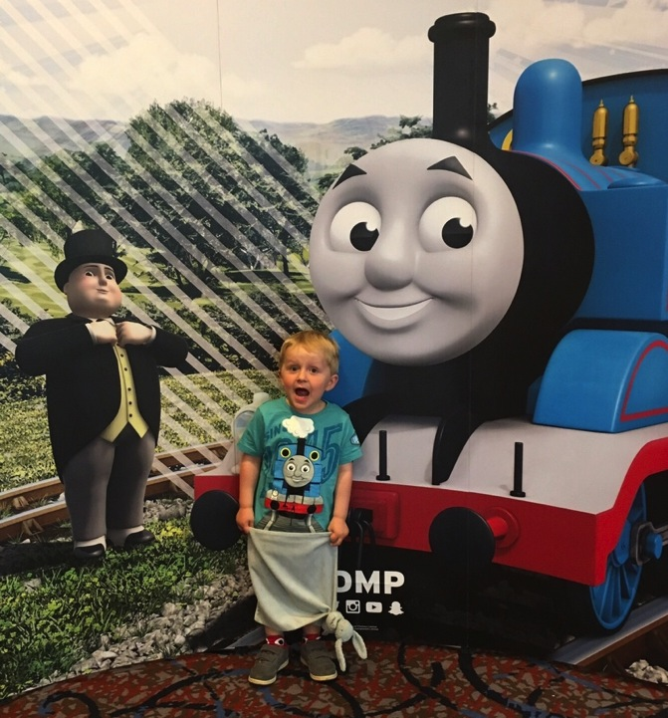

Slide 46
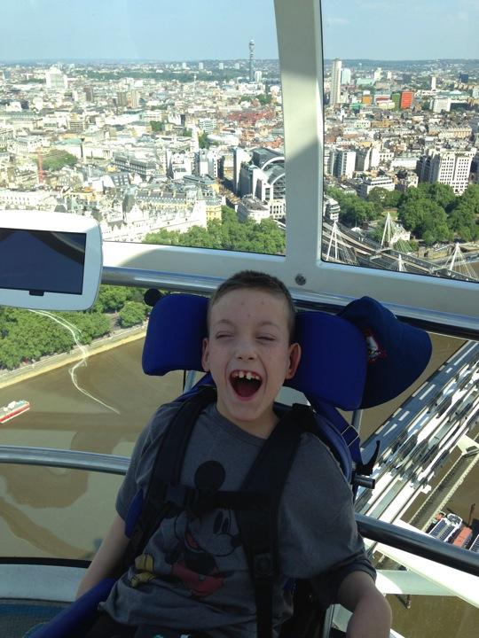

Slide 47
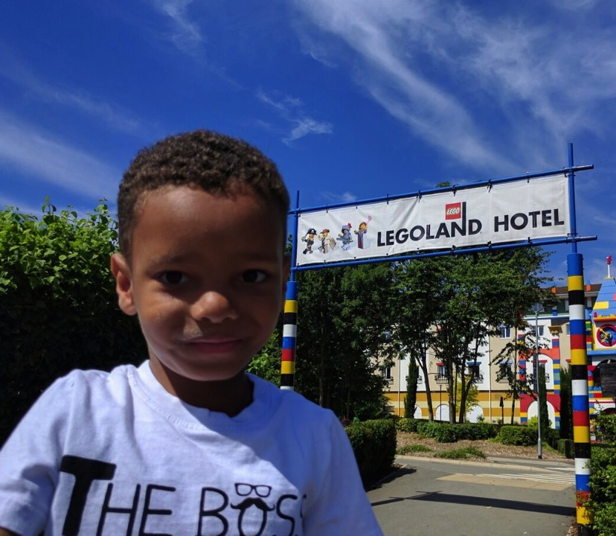

Slide 48
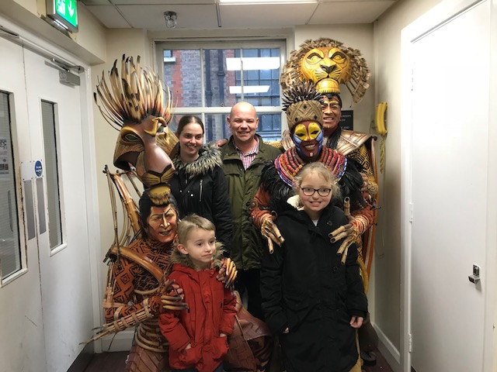

Slide 49
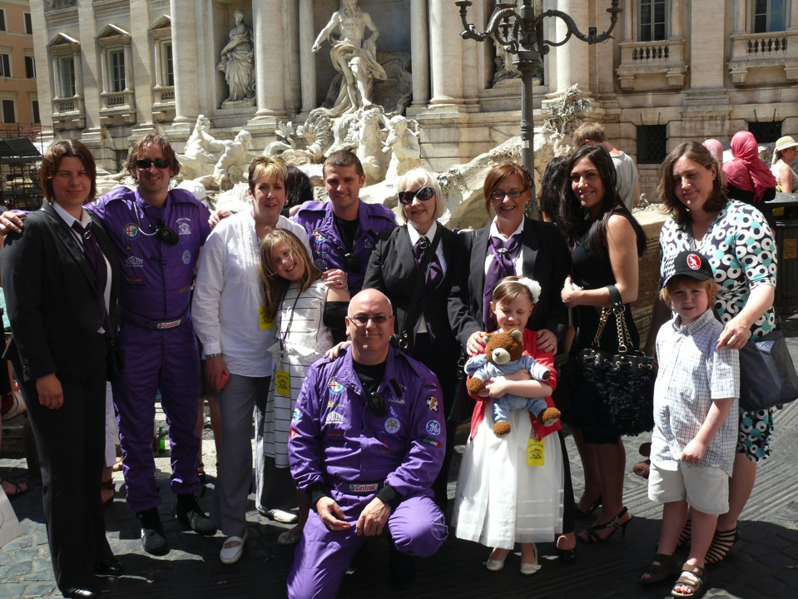

Slide 50
Our most popular wish is to visit Disneyland Paris

Slide 51
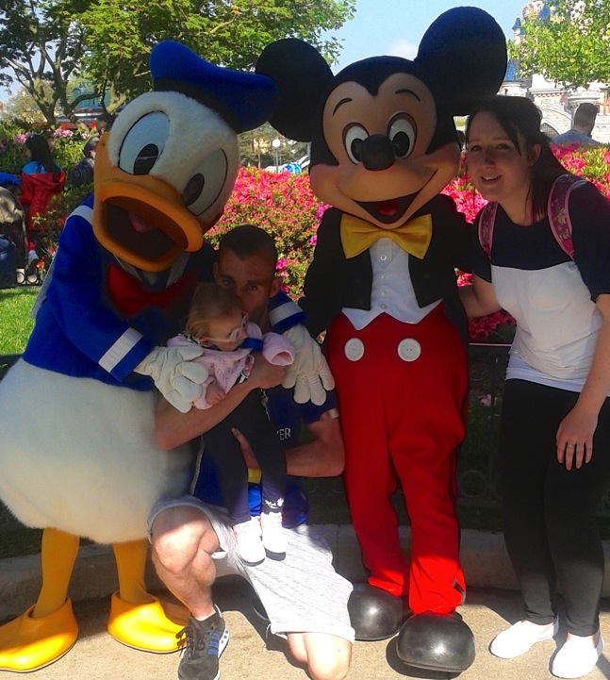

Slide 52
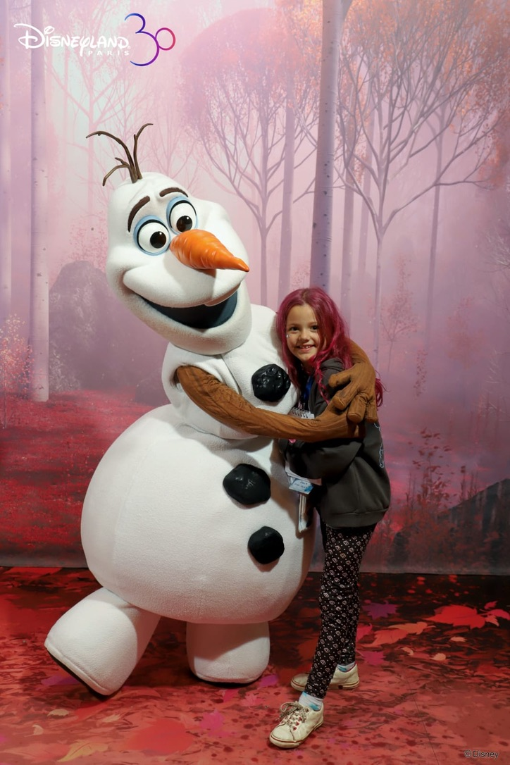

Slide 53
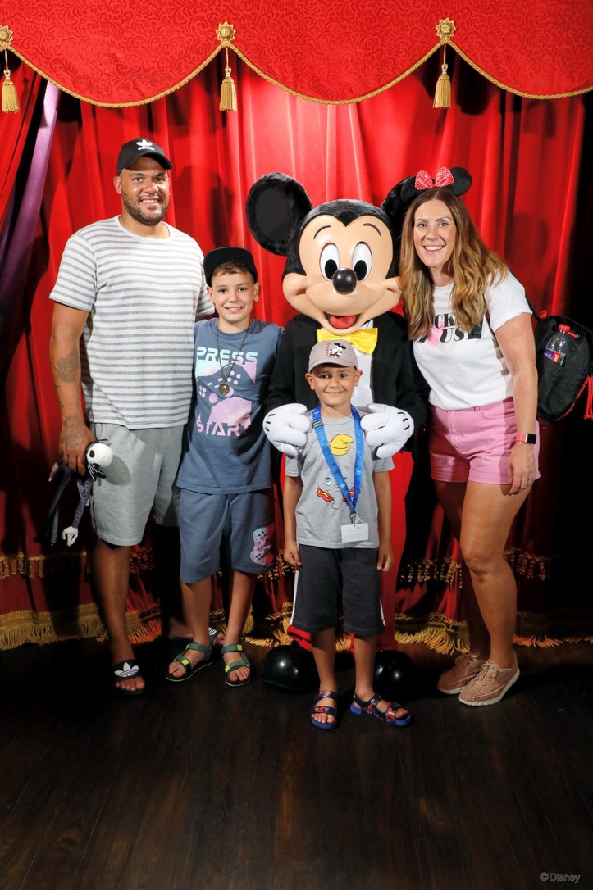

Slide 54
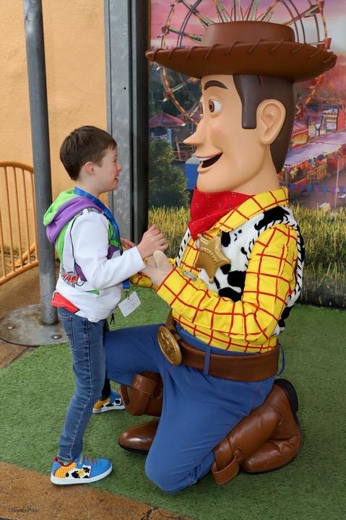

Slide 55
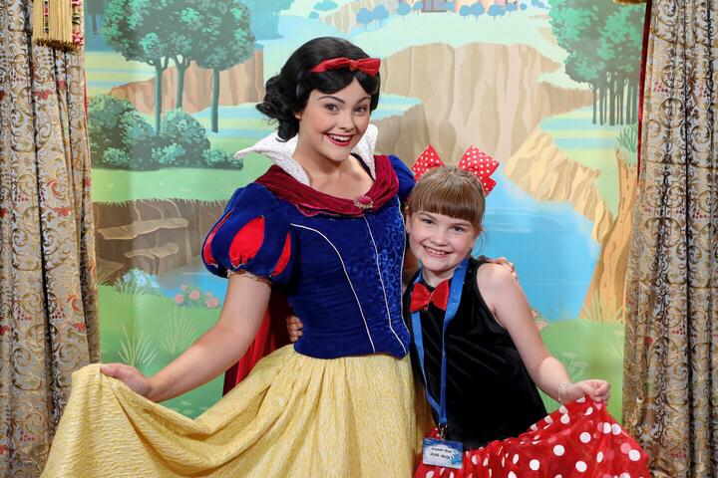

Slide 56
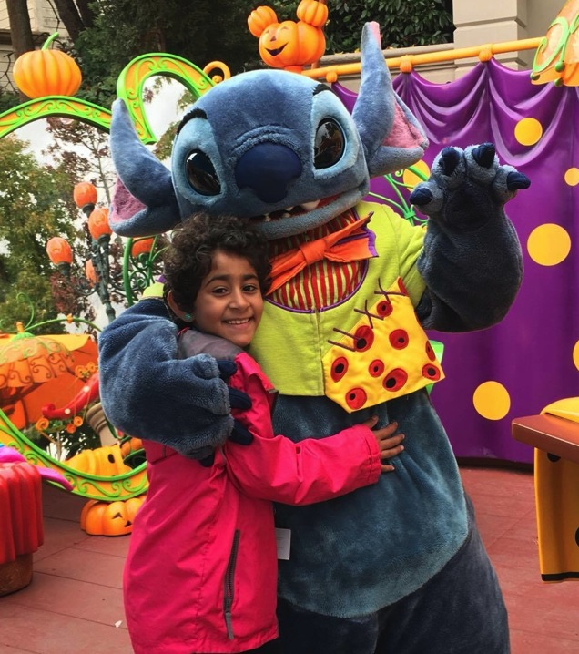

Slide 57
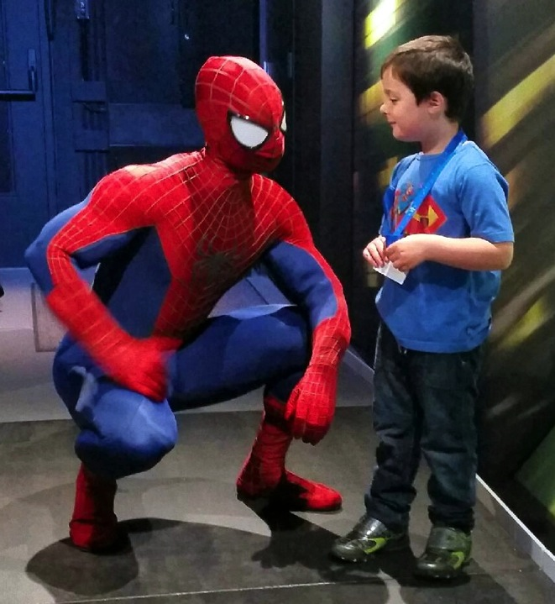

Slide 58
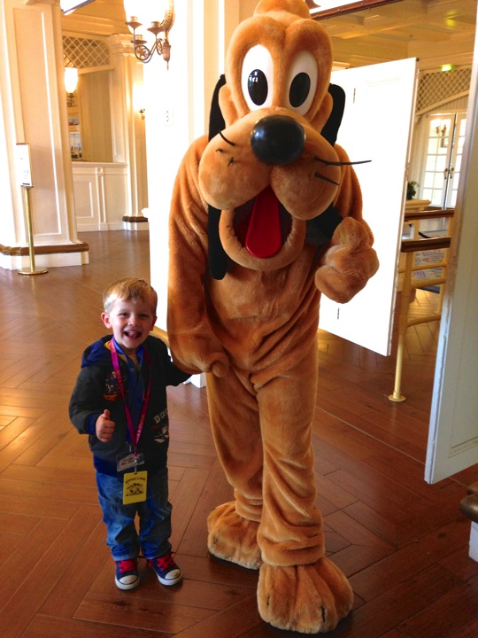

Slide 59
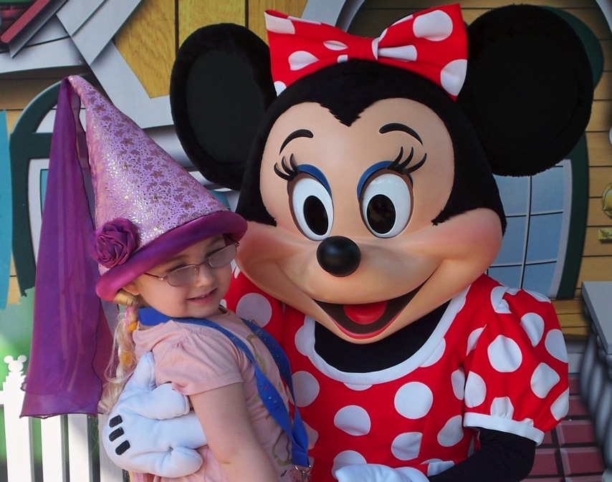

Slide 60
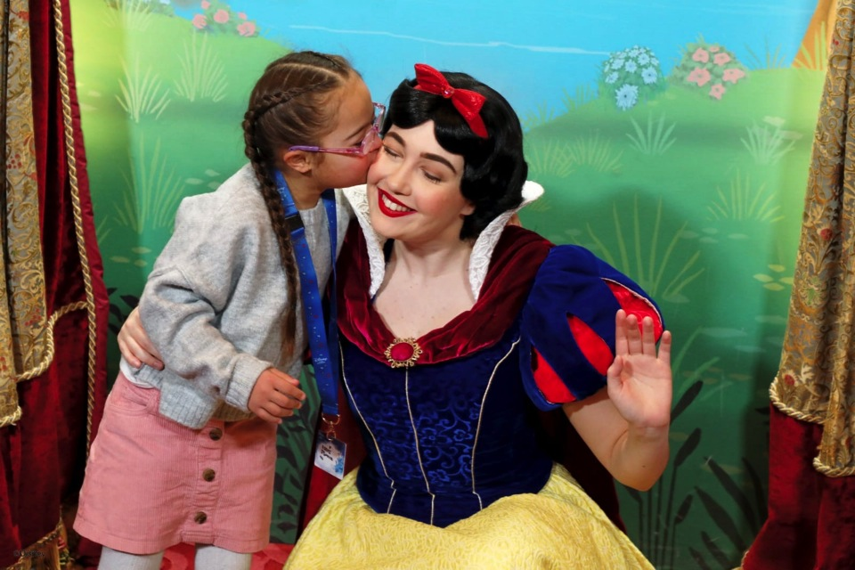

Slide 68
We consider ourselves to be one huge family, so each year we organise trips and special days out for our wish children and their families. These include pantomimes, parties, theme parks, circus trips and other events that we are invited to.

Slide 79
Wishes 4 Kids is funded solely by public donation. The Charity does not receive Government funding nor financial support from either the National or Health Lotteries. It is the people and businesses of Leicestershire – people like yourselves – that enable the Charity to make children and young people’s wishes a reality.

Slide 80
There have been lots of fundraising ideas over the years:

Slide 92
It would not be possible for the Charity to succeed in achieving its goal if it were not for the dedicated team of individuals who work extremely hard behind the scene:

Slide 93
Wishes 4 Kids Patrons
Alan Birchenall Muzzy Izzet John Greaves

Slide 94
Wishes 4 Kids Ambassadors
Martin Hulbert Richard & Angela Nicky & Vic Adcock Caroline James
Bebbington Thompson Woofenden
Shaun Kirk Parin Suchak Mick Brown Trace Voss Michael Loraine & Jock
Davison Moon

Slide 95
Wish Ambassadors
Eve Brant Millie Rushin

Slide 96
Wishes 4 Kids Trustees
Paul Bakewell Wendy Brickett
Chair of Trustees
Trudie Seers Paul & Shirley McKenna Paula McAllister

Slide 97
Wish Squad
Charity Manager
Gary Lowe Vikki Lowe Bev Jarvis
Charity Manager

Slide 98
Please help us to ensure we can grant every child’s wish whilst there is still time.

Slide 99
Finally - from everyone at the Charity but most of all, from the children and young people whose wishes have been granted by people like yourselves, we would like to say Thank You

Slide 101
Registered Charity No. 1092962 Tel: 0116 2543491 Fax: 0116 2543492 info@wishes4kids.co.uk www.wishes4kids.co.uk

